Slide 1
Hemispherical Confocal Imaging using Turtleback Reflector
ACCV2010
Yasuhiro Mukaigawa (Osaka University)
Seiichi Tagawa (Osaka University)
Jaewon Kim (MIT Media Lab)
Ramesh Raskar (MIT Media Lab)
Yasuyuki Matsushita (Microsoft Research Asia)
Yasushi Yagi (Osaka University)

Slide 2
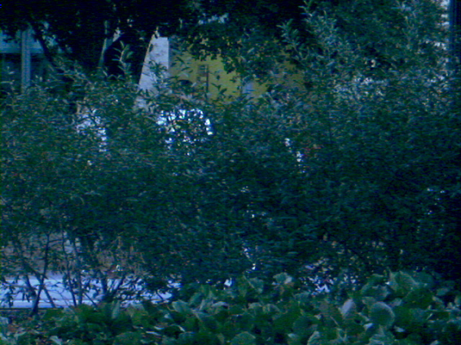
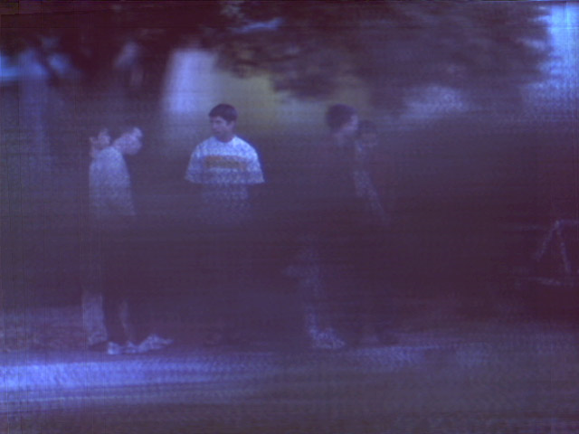

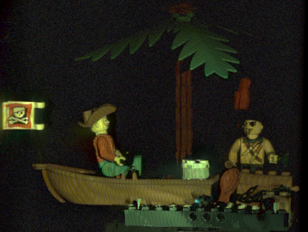
Motivation
Clear view of a particular depth in the scene
Reduction of undesirable phenomena such as
Occlusion
Scattering
[Vaish et al. CVPR2004]
[Fuchs et al. EGSR2008]

Slide 3
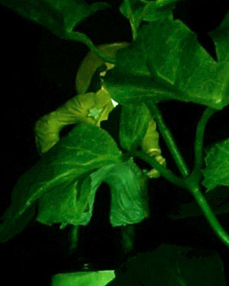
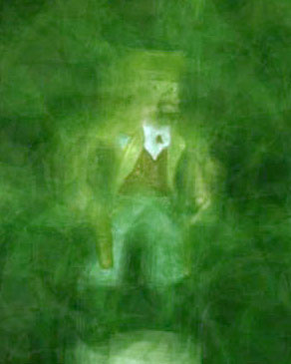
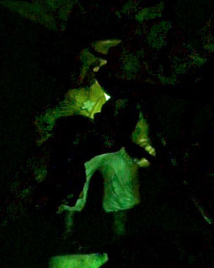
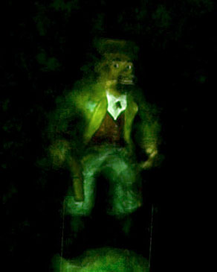
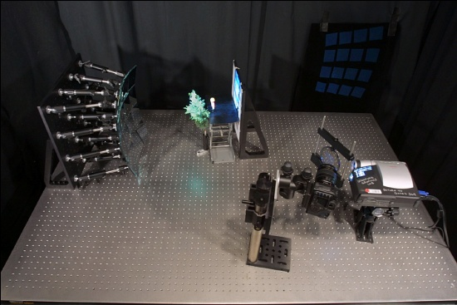
Related works
[Levoy et al. SIGGRAPH2004]
source
detector
Normal view
Synthetic aperture
Confocal imaging
Problems:
Limited aperture size
Scattering
Synthetic aperture confocal imaging

Slide 4
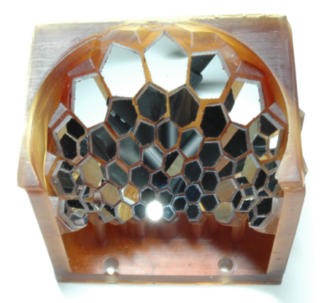
Our idea: Hemispherical confocal imaging
Optical device
Specially designed polyhedral mirror
Synthesis of huge aperture
Image analysis
Pattern projection from many projectors
Focused illumination & descattering

Slide 5
Huge aperture
Hemispherical aperture
does not exist
how to realize?
Advantages of huge aperture
  extremely shallow DOF
  clear view of the particular depth
?
DOF
Aperture
size
Small
Large
Huge
F-number: 0
FOV: 180 [degree]

Slide 6
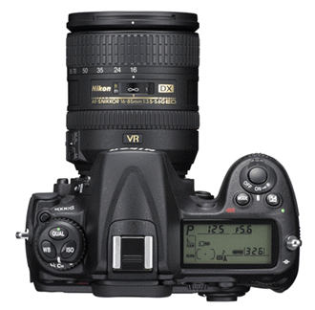
Hemispherical synthetic aperture
Synthetic aperture technique
  many cameras on a hemisphere
  uniform distance and density
  problems: cost and physical conflict
Virtual cameras using planar mirrors
Real camera
Virtual cameras
Target object
Planar mirrors

Slide 7
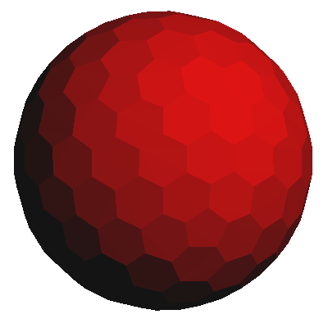
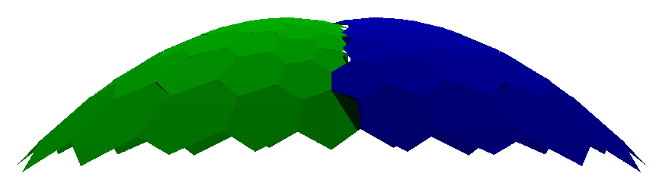
Design of polyhedral mirror
Virtual cameras
Projection onto
the ellipsoid
Geodesic dome
Hemisphere
Target object
Ellipsoid
Real camera

Slide 8
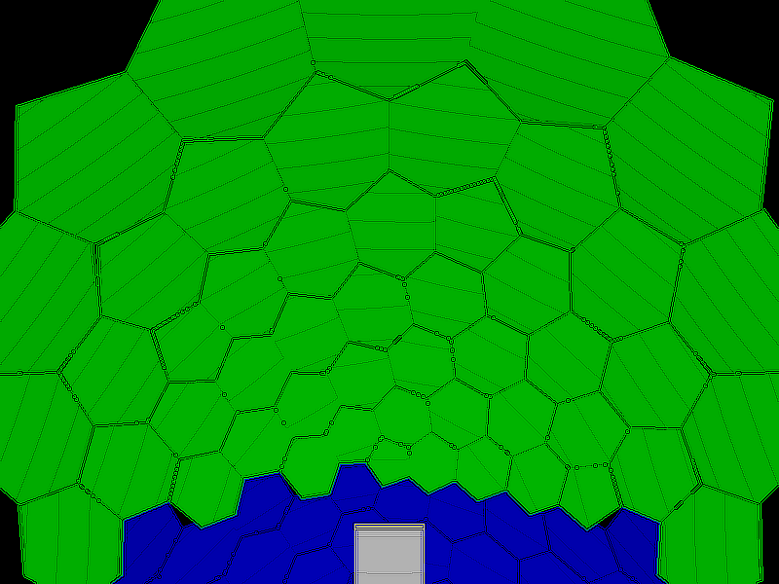
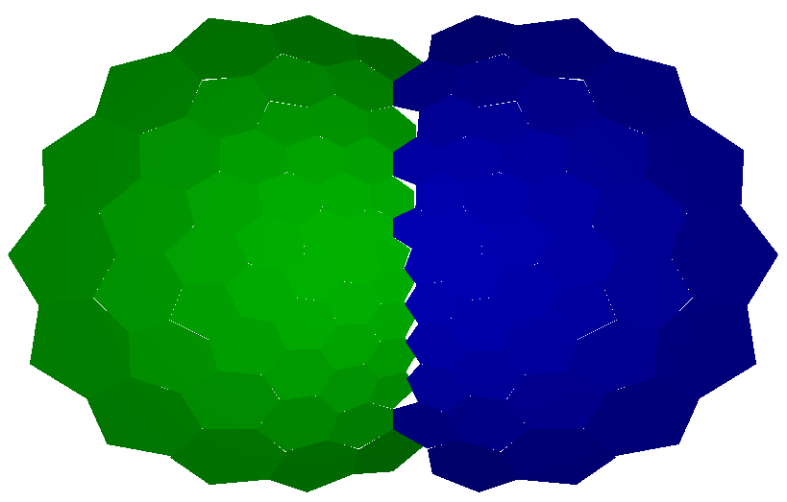
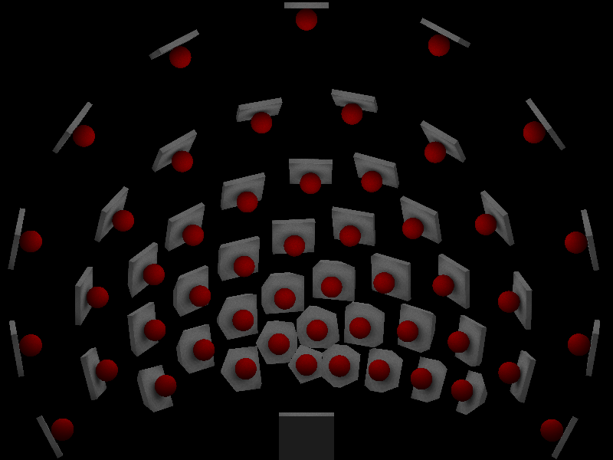
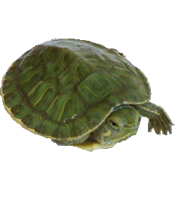
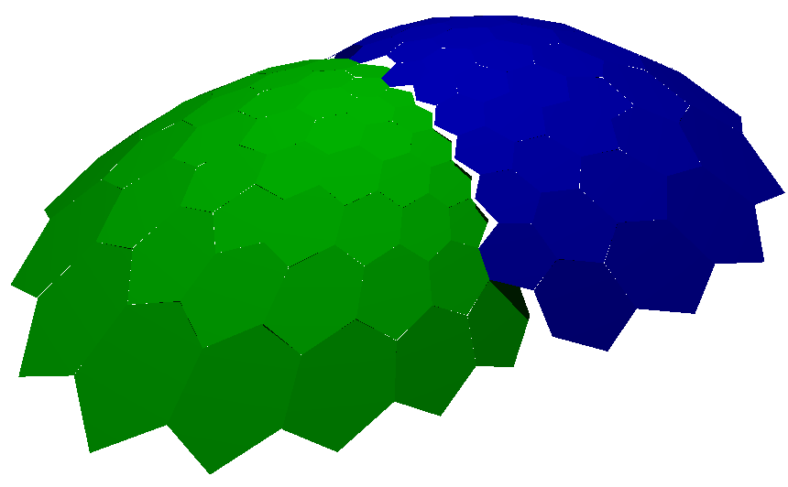
Turtleback reflector
View from a real camera
Simulation by POV-Ray

Slide 9
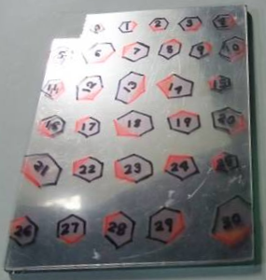
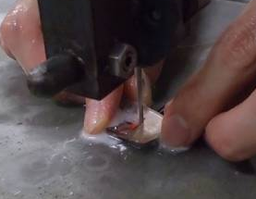
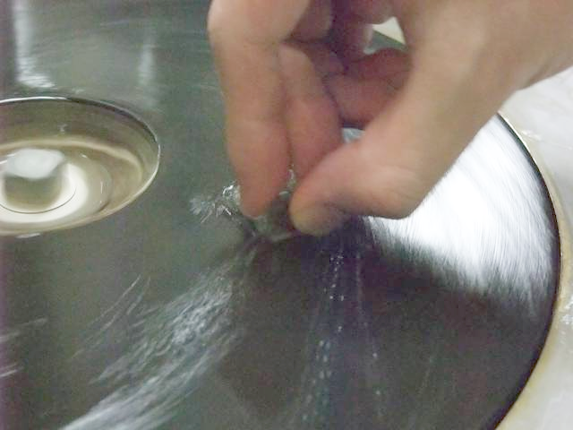

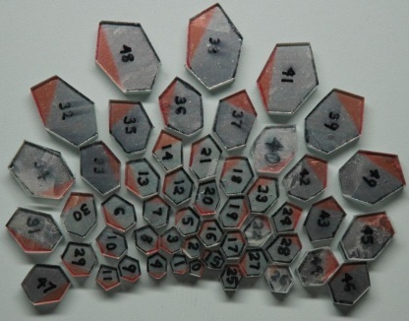
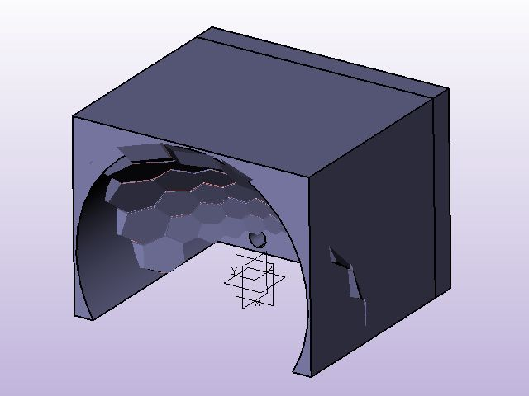
How to make turtleback reflector
First-surface mirror
Cut
Grind
Planar mirrors
Plastic frame
Turtleback reflector
(cost: 50US$)

Slide 10
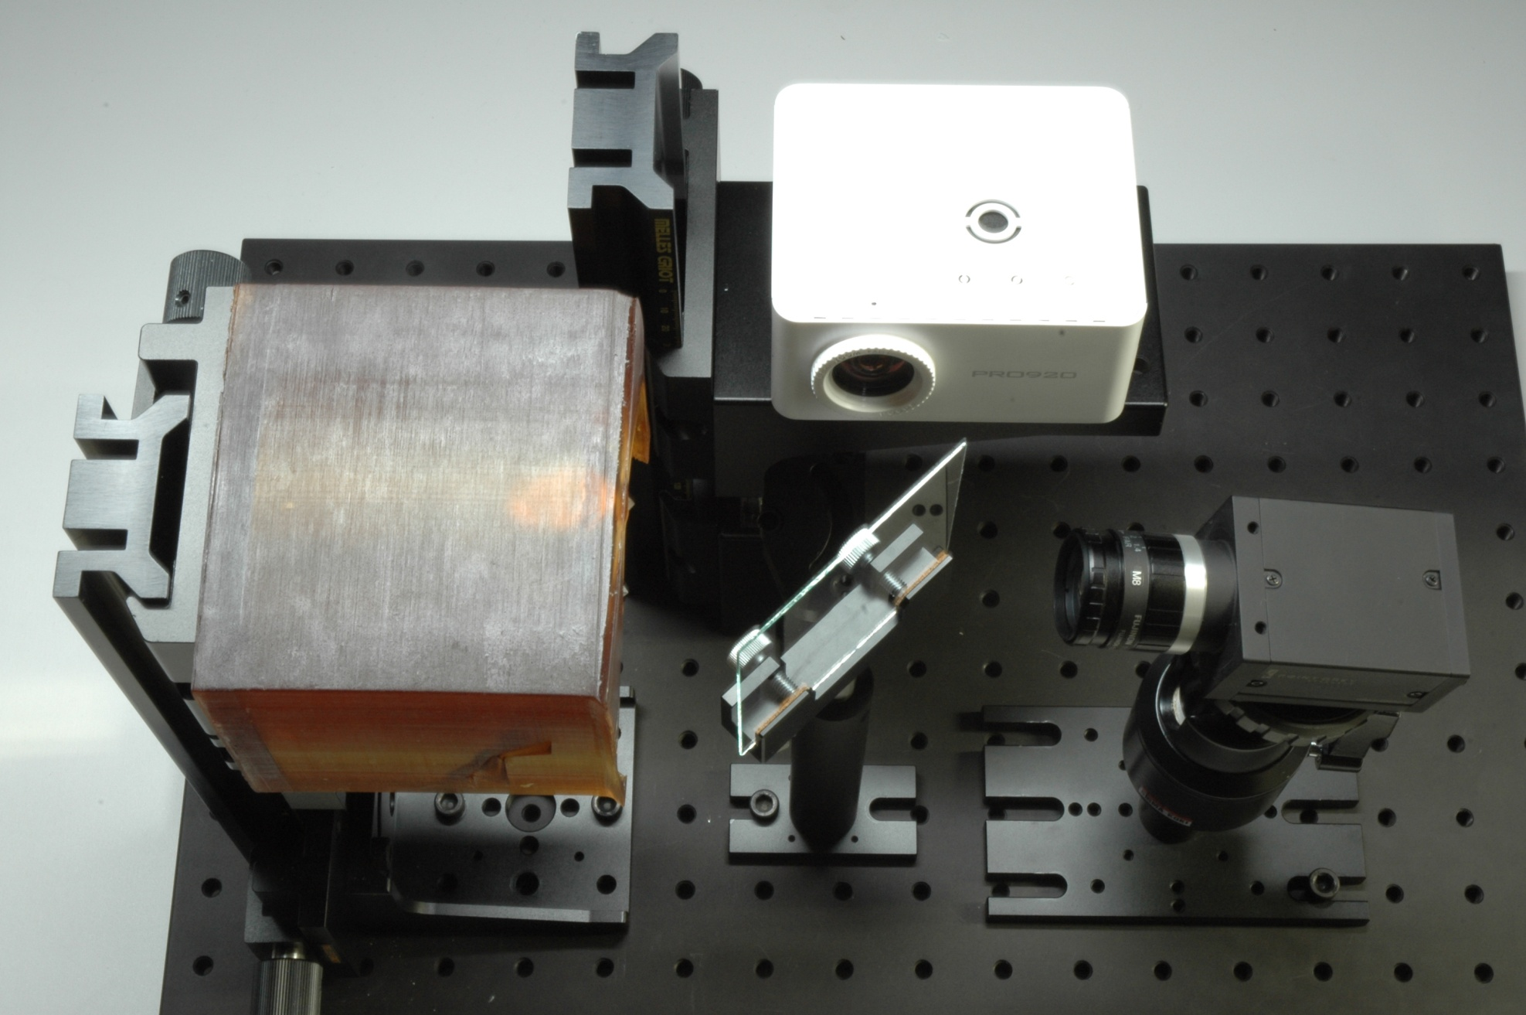
Overview of the imaging system
Projector
Turtleback reflector
Camera
Beam splitter

Slide 11

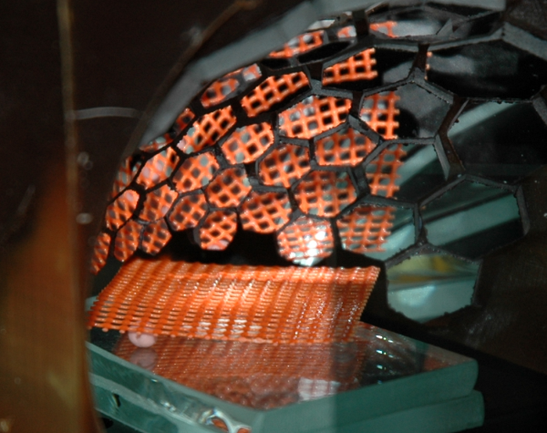




Preliminary experiment (1)
Hemispherical synthetic aperture
Orange mesh
2mm
Textured paper
# of camera
1
3
12
48
Aperture
Small
Large
Hemisphere

Slide 12








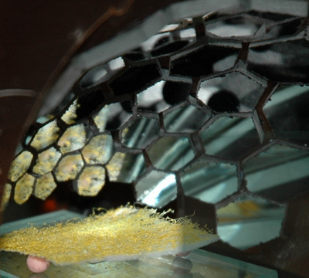
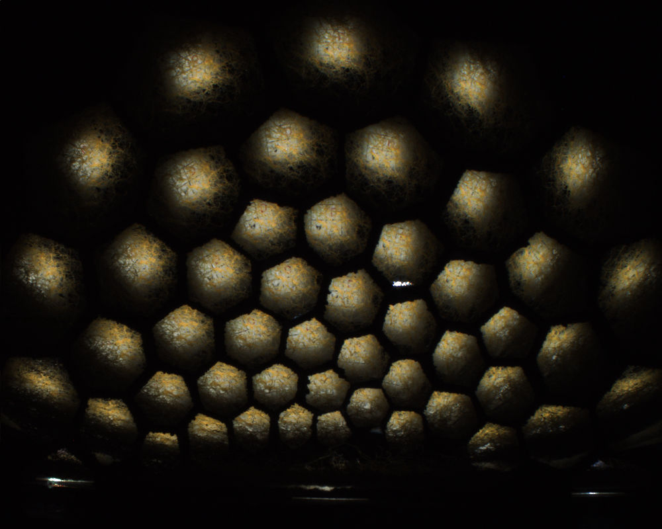
Preliminary experiment (2)
Covered by yellow dense mesh
...
Small
Large
Hemisphere
2400x2000

Slide 13
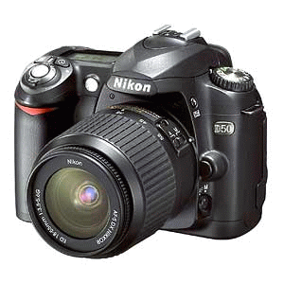
Decomposition
Undesired phenomena
  reflection from unfocused depth
  scattering
Eliminate undesired components
Blurred mesh
Direct reflection from
the focused depth
Light
source
Reflection from
unfocused depth
Eliminate
Special illumination using
Turtleback reflector
Scattering
Focused
depth

Slide 14
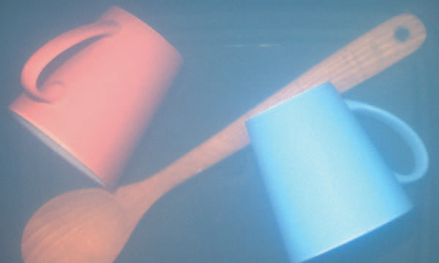
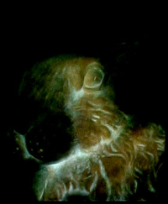
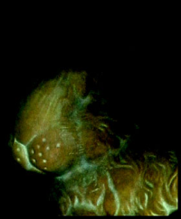
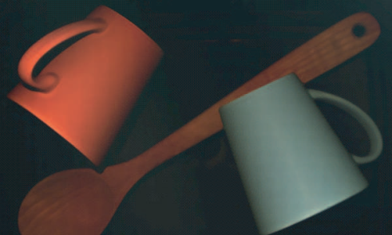
Special illumination
Focused illumination
High frequency illumination
Illuminate the particular depth
Separate direct / global components
[Levoy et al. 2004]
[Nayar et al. 2006]
New idea: Focused High Frequency Illumination (FHFI)
High frequency patterns are focused only on the particular depth

Slide 15
Focused High Frequency Illumination
Projection of high frequency positive and negative patterns
  blurred in unfocused region
  constant scattering
Positive pattern
Negative pattern
Max – Min
Positive
1
1/2
1/2
Negative
0
1/2
1/2
Max-Mix
1
0
0
Focused
Unfocused
Eliminated
Scattering

Slide 16








Experimental results of FHFI
Covered by orange mesh
Covered by diffuse sheet
Normal
illumination
Hemispherical
aperture
FHFI
FHFI
+
Hemispherical aperture
Normal
illumination
FHFI
(descattering)

Slide 17
Position of our method
unfocused
depth
scanning
scattering
Synthetic aperture
Confocal imaging
Synthetic aperture confocal imaging
Confocal imaging with descattering
Hemispherical confocal imaging
bright
darken
unilluminated
darken
unilluminated
unnecessary
necessary
unnecessary
necessary
unnecessary
remaining
remaining
partially reduced
reduced
reduced
Limitations
  The resolutions of virtual cameras and projectors are low.
  The observable area is narrow.

Slide 18

Conclusion
Hemispherical confocal imaging to see a clear view of the particular depth
  Hemispherical synthetic aperture by designing Turtleback reflector
  Clear view of the particular depth by FHFI
Future works: evaluation, application
Factorization (skipped)
(1)
(2)
(3)

Slide 19
END

Slide 20
Factorization
Dark regions due to absorption and occlusion
Factorization into three terms
A
B
C
absorption
occlusion
Camera A
Camera B
Camera C
=
x
x
Observed views
Masking terms
Reducing terms
Texture term

Slide 21
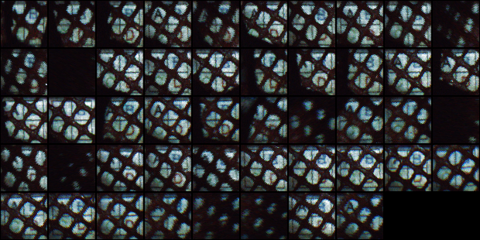


Experimental result of Factorization
FHFI +
Hemispherical aperture
Observed views from virtual cameras
=
x
x
...
...
...
Observed views
Masking terms
Reducing terms
Texture term

Slide 22
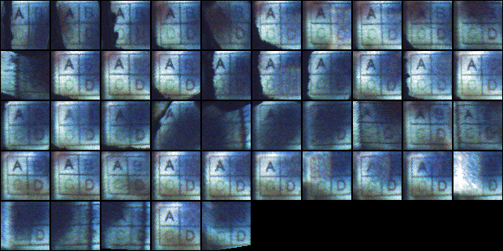

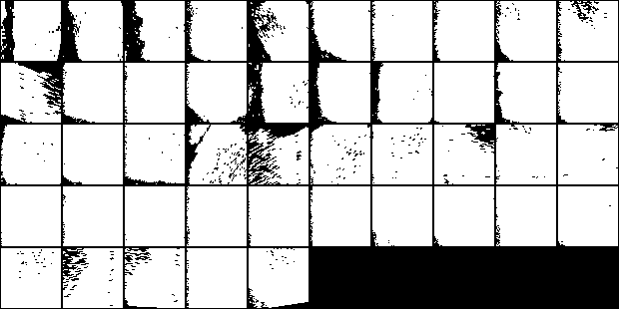
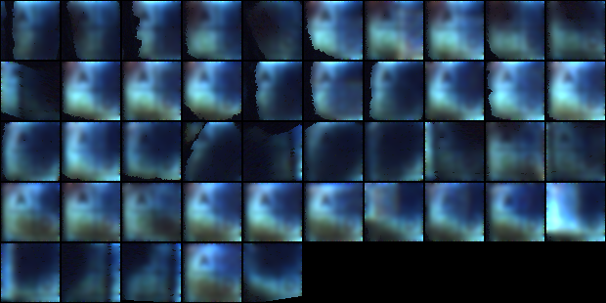
Factorization
=
X
texture
observation
X
masking
attenuation

Slide 23
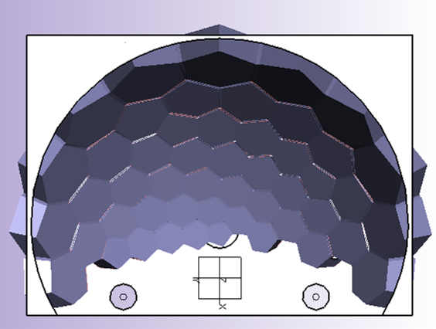
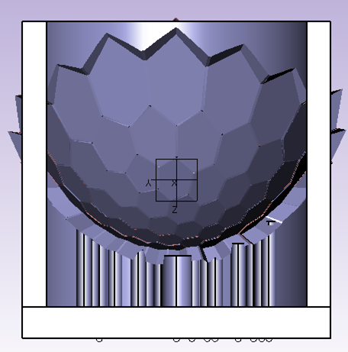
Design of Turtleback reflector
Virtual cameras and projectors on the nodes of a geodesic dome
Circumscribed polyhedron to ellipsoid
75mm
90mm
100mm

Slide 24

Turtleback reflector
50 first-surface mirrors
Plastic base by Stereolithography

Slide 25
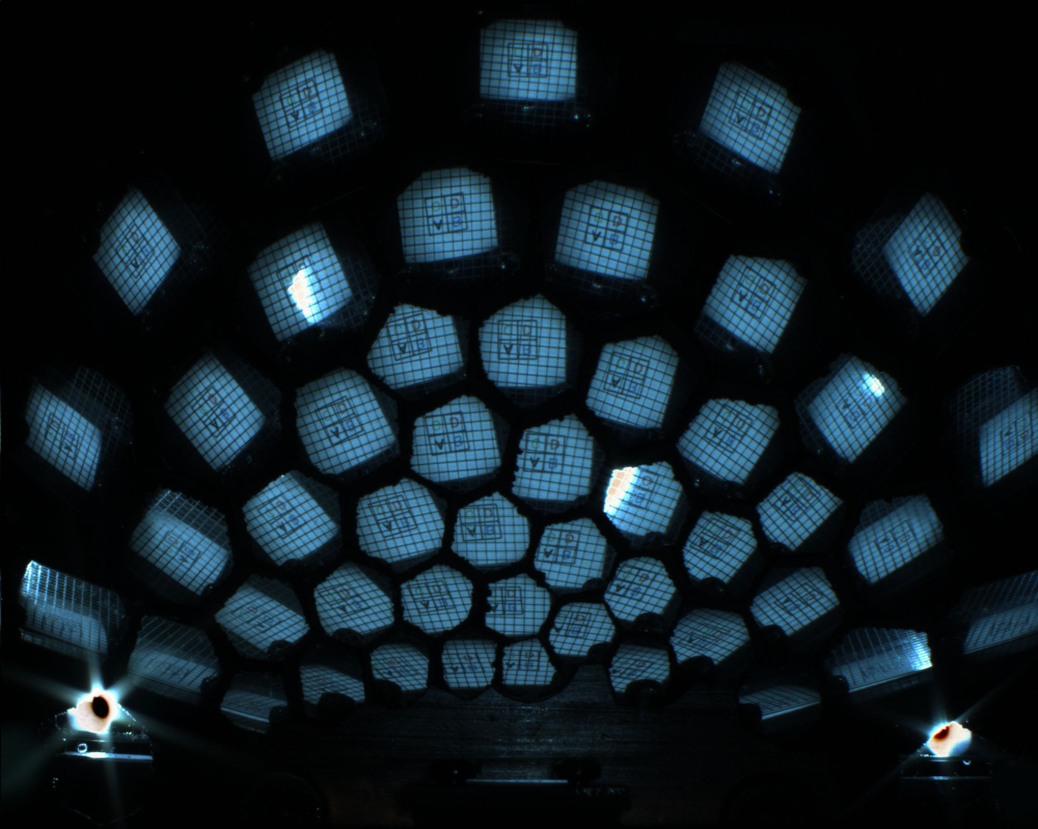
Captured image
2mm
A
B
C
D
transparent sheet
printed paper
2000x1600

